Slide 1
Department of Artificial Intelligence
Speech to Emoji Converter

Slide 2
TEAM DETAILS
S.NO | Name | Department | Contribution ( What part of the project you contributed ) | Status
1 | Ashwat N | CSE |  | Completed
2 | Rithish Kannan J | IT |  | Completed
3 | Jayanth Kumaar MS | AI&DS |  | Completed

Slide 3
ABSTRACT
This code implements a real-time speech-to-text-to-emotion-to-emoji pipeline. It uses OpenAI's Whisper model to transcribe spoken words into text, and then employs a pre-trained emotion detection model to analyze the sentiment of the transcribed text. Based on the detected emotion (e.g., joy, sadness, anger), an appropriate emoji is generated. The program continuously listens to microphone input, transcribes speech, detects emotions, and displays the corresponding emoji, providing an interactive and visual representation of emotions in real-time.

Slide 4
OBJECTIVE
The objective of this project is to develop a real-time system that combines three key technologies: speech recognition, emotion detection, and emoji mapping. The system listens to spoken input, converts the speech into text using the Whisper model, and analyzes the emotional tone of the transcribed text through an emotion detection model. Based on the identified emotion (such as joy, sadness, anger, etc.), the system maps the emotion to an appropriate emoji for visual representation. This interactive and intuitive system enhances user experience by providing immediate emotional feedback in the form of emojis, making it more engaging and user-friendly for applications such as virtual assistants, interactive voice systems, or fun emotional recognition apps.

Slide 5
FEATURE
Real-Time Speech-to-Text Conversion: Utilizes the Whisper model to transcribe spoken language into text in real-time, allowing for seamless speech recognition.
Emotion Detection: Leverages a pre-trained emotion detection model to analyze the sentiment of the transcribed text and identify emotions like joy, sadness, anger, surprise, etc.
Emoji Mapping: Maps the detected emotions to corresponding emojis, providing a visual representation of the emotions in a simple and intuitive way.
Continuous Listening: The system continuously listens to microphone input, processes audio in real-time, and generates immediate results without manual intervention.
Interactive User Experience: Combines voice input, emotional analysis, and emoji output to create an engaging and interactive user experience.

Slide 6
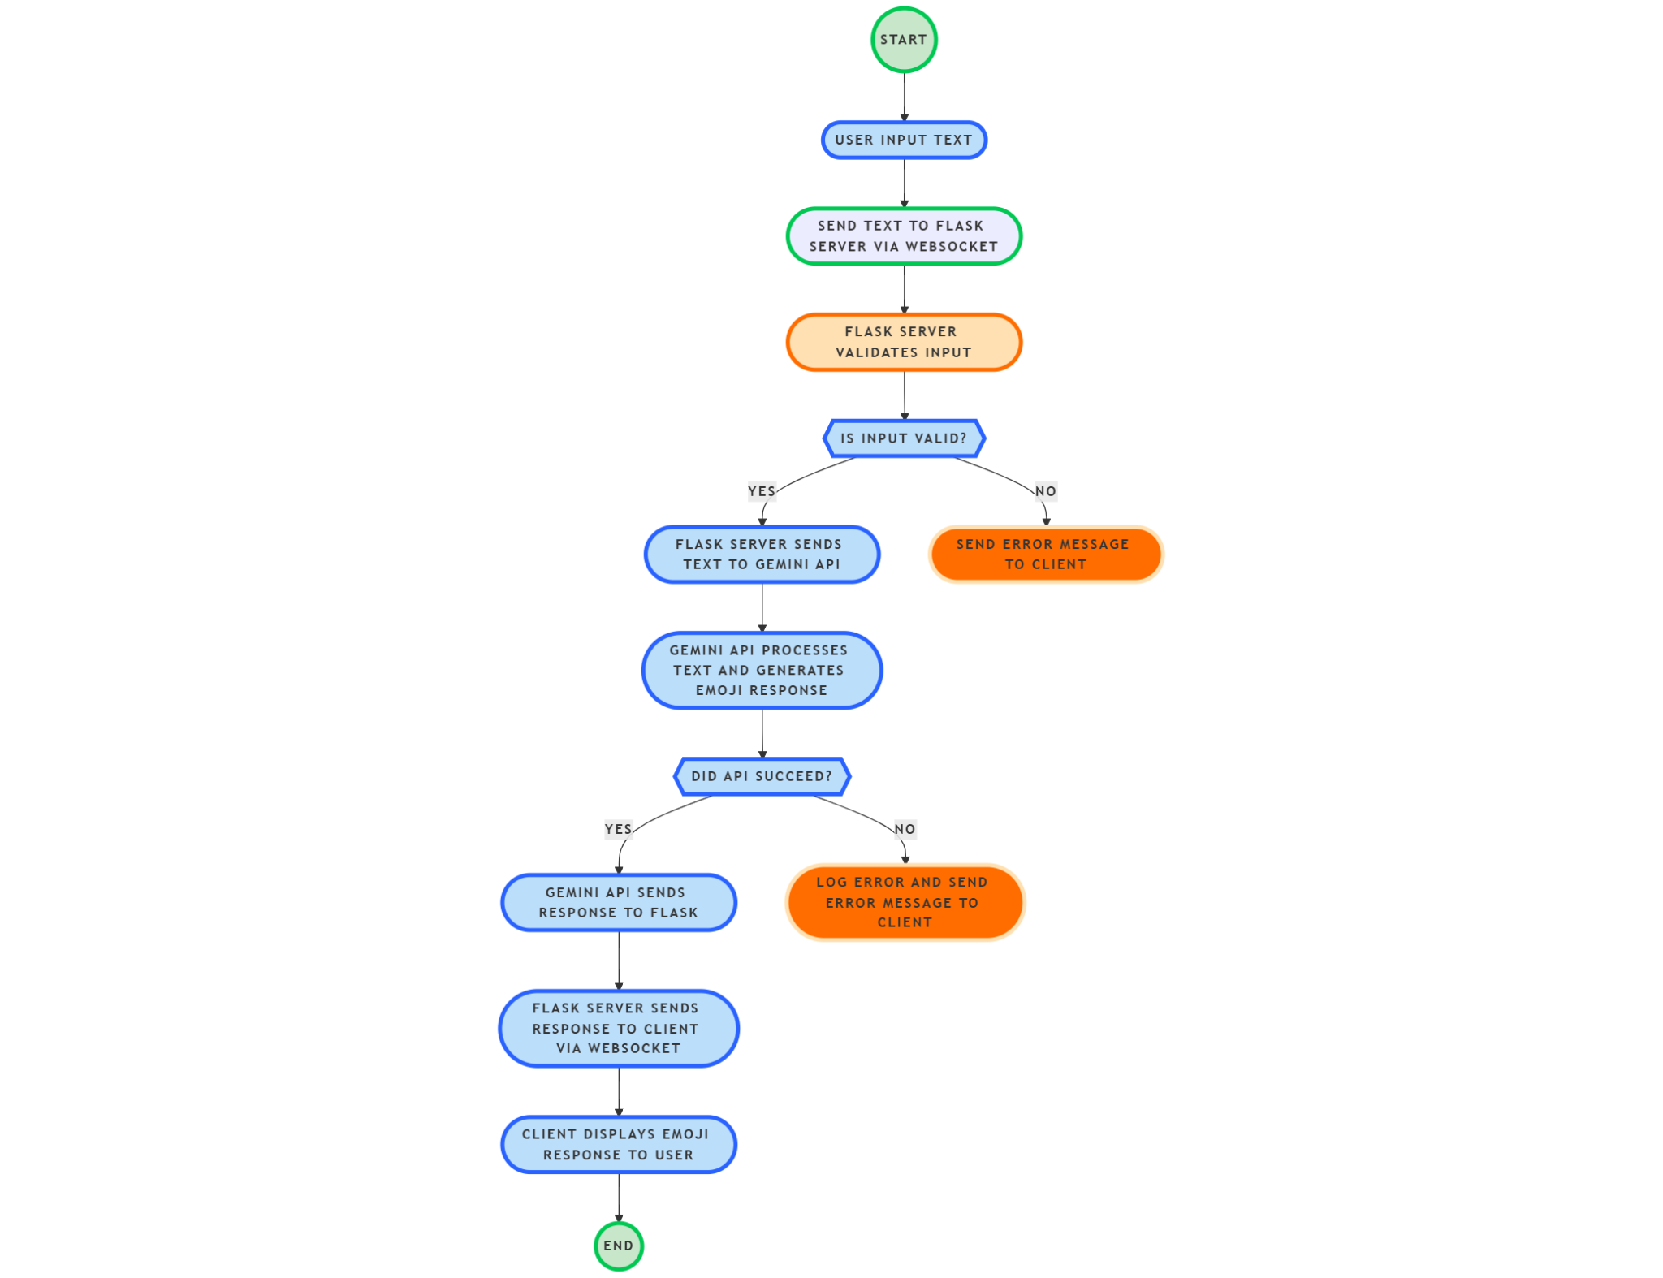
FLOWCHART

Slide 7
TECHNOLOGY USED
Frontend Technology
Backend Technology
What ML Model Used
Components | Technology | Purpose
Speech recognition(ASR) | OpenAI Whisper | Converts speech to text
Emotion detection | Hugging Face Transformers | Analyses texts detects emotions
Real-Time Audio Capture | Sound Device | Captures live microphone outputs
Audio processing | NumPy | Converts raw audio data for processing
Components | Technology | Purpose
User Interface(UI) | HTML/CSS/JavaScript | Display speech to emoji output
Frontend frame | React.js/Vue.js | For interactive and dynamic UI
Speech Input UI | Microphone Button | Captures audio from users
Emoji Display | JavaScript/HTML DOM | Shows detected emotions as emoji
Communication with Backend | Fetch API/WebSocket | Sends speech data & recieves emoji responses
Components | Model | Purpose | Source
Speech recognition(ASR) | Whisper | Converts speech to text | OpenAI
Emotion detection | DistilRoBERTa | Analyses text and emotions | Hugging face

Slide 8
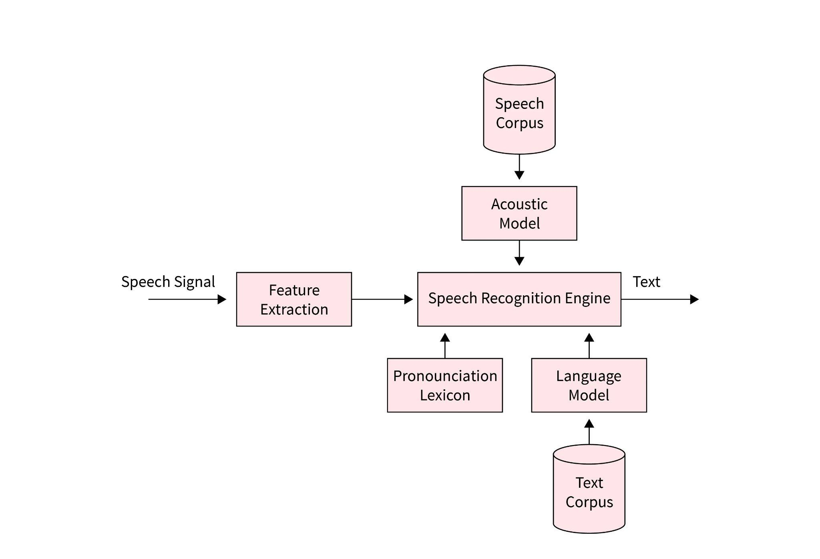
SYSTEM ARCHITECTURE

Slide 9
TARGET CUSTOMERS
1. Developers & AI Enthusiasts
People interested in AI-driven real-time speech processing.
Developers working with Whisper ASR, NLP, and sentiment analysis.
Those exploring Hugging Face emotion models and Flask for AI integration.
2. Accessibility & Assistive Tech Users
People with hearing impairments who might benefit from visual emotional cues.
Users who need text-to-emoji translation for better communication in digital spaces.
3. Social Media & Content Creators
Streamers or content creators who want to convert speech into emoji reactions for interactive engagement.
Developers building emoji-based chatbots or auto-reaction tools for live platforms.
4. Customer Support & Sentiment Analysis
Businesses integrating real-time emotion detection for call centers or AI-driven customer support.
Applications that analyze customer sentiment in conversations and provide real-time feedback.
5. Researchers & Academics
NLP researchers focusing on real-time emotion detection from speech.
Academics studying human-computer interaction (HCI) through emotional AI.

Slide 10
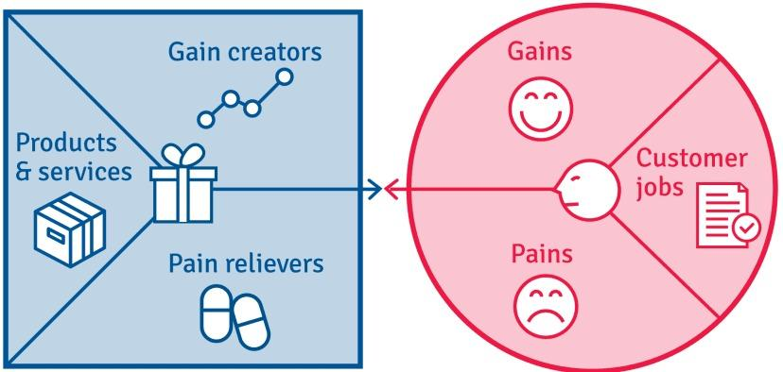
CUSTOMER VALUE PROPOSITION
CUSTOMER PROFILE
Gains
Enhanced
Communication
Engagement
Pains
Accuracy Latency Scalability
Customer Jobs
Communication
Emotion Detection
Accessibility
Automation
User Engagement Reaction

Slide 11
RESULT & CONCLUSION
This project successfully implements a real-time speech-to-emoji AI system that converts spoken words into corresponding emotional emojis. By leveraging Whisper for Automatic Speech Recognition (ASR) and a Hugging Face emotion classification model, the system processes live speech input, detects emotions, and provides intuitive emoji-based feedback.
This project serves as a strong foundation for integrating AI-driven emotional intelligence into interactive applications. With further enhancements, it can be expanded into a scalable, real-time emotion-aware system for diverse industries, including customer engagement, accessibility, and entertainment

Slide 12
Thank You
Our github link:https://github.com/Jayanthkumaarms/speech_to_emoji

